Slide 1
Lecture 11 Bayesian Inference
CS 180 – Intelligent Systems
Dr. Victor Chen
Fall 2022

Slide 2
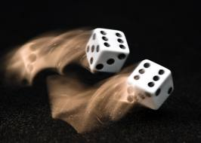
Review on Probability Theory

Slide 3
Random variables
We use random variables to describe uncertain state. Random variables take on values in a domain.
R: Is it raining?
R in {True, False}
W: What’s the weather?
W in {Sunny, Cloudy, Rainy, Snow}
D: What is the outcome of rolling two dice?
D in {(1,1), (1,2), … (6,6)}
S: What is the speed of my car (in MPH)?
S in [0, 200]

Slide 4
Events
Event: a complete assignment of values to all random variables
E.g., if two Boolean variables Cavity and Toothache,
Then there are four distinct events:
Cavity = false ∧Toothache = false Cavity = false ∧ Toothache = true Cavity = true ∧ Toothache = false Cavity = true ∧ Toothache = true

Slide 5
Joint probability
A joint probability P(X₁ = x₁, X₂ = x₂, …, X_{n} = x_{n}) refers to the probability of an event.
The joint probabilities of all the events must sum to 1
Atomic events | P
Cavity = false ∧Toothache = false | 0.8
Cavity = false ∧ Toothache = true | 0.1
Cavity = true ∧ Toothache = false | 0.05
Cavity = true ∧ Toothache = true | 0.05

Slide 6
Marginal (prior) probability
If you sum the joints of all events where X = x, you get the marginal (prior) probability P(X = x)

Slide 7
Derive marginal from joint
P(Cavity, Toothache)
Cavity = false ∧Toothache = false | 0.8
Cavity = false ∧ Toothache = true | 0.1
Cavity = true ∧ Toothache = false | 0.05
Cavity = true ∧ Toothache = true | 0.05
P(Cavity)
Cavity = false | ?
Cavity = true | ?
P(Toothache)
Toothache = false | ?
Toochache = true | ?

Slide 8
Derive marginal from joint
P(Cavity, Toothache)
Cavity = false ∧Toothache = false | 0.8
Cavity = false ∧ Toothache = true | 0.1
Cavity = true ∧ Toothache = false | 0.05
Cavity = true ∧ Toothache = true | 0.05
P(Cavity)
Cavity = false | 0.9
Cavity = true | 0.1
P(Toothache)
Toothache = false | 0.85
Toochache = true | 0.15

Slide 9
Conditional probability (likelihood)
For any two events A and B,
P(A ∧ B)
P(A)
P(B)

Slide 10
Derive conditional from joint
P(Cavity, Toothache)
Cavity = false ∧Toothache = false | 0.8
Cavity = false ∧ Toothache = true | 0.1
Cavity = true ∧ Toothache = false | 0.05
Cavity = true ∧ Toothache = true | 0.05
P(Cavity)
Cavity = false | 0.9
Cavity = true | 0.1
P(Toothache)
Toothache = false | 0.85
Toothache = true | 0.15
What is P(Cavity = true | Toothache = false)?
P(Cavity = true ∧ Toothache = false)/P(Toothache = false) = 0.05 / 0.85 = 0.059
What is P(Cavity = false | Toothache = true)?
P(Cavity = false ∧ Toothache = true)/P(Toothache = true) = 0.1 / 0.15 = 0.667

Slide 11
Derive conditional from joint
P(Cavity, Toothache)
Cavity = false ∧Toothache = false | 0.8
Cavity = false ∧ Toothache = true | 0.1
Cavity = true ∧ Toothache = false | 0.05
Cavity = true ∧ Toothache = true | 0.05
P(Cavity | Toothache = true)
Cavity = false | 0.667
Cavity = true | 0.333
P(Cavity| Toothache = false)
Cavity = false | 0.941
Cavity = true | 0.059
P(Toothache | Cavity = true)
Toothache= false | 0.5
Toothache = true | 0.5
P(Toothache | Cavity = false)
Toothache= false | 0.889
Toothache = true | 0.111

Slide 12
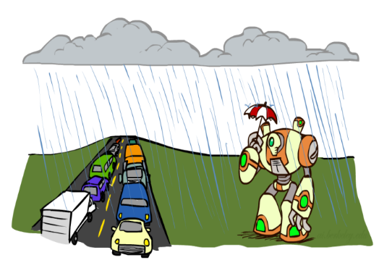
Derive joint from conditional
Chain rule:

Slide 13
Independence
Two events A and B are independent iff P(A, B) = P(A) P(B)
In other words, P(A | B) = P(A) or P(B | A) = P(B)
Conditional independence: A and B are conditionally independent given C iff P(A, B | C) = P(A | C) P(B | C)
Equivalently: P(A | B, C) = P(A | C) or P(B | A, C) = P(B | C)

Slide 14
Conditional independence: Example
Toothache: if the patient has a toothache
Cavity: if the patient has a cavity
Catch: if the dentist’s probe catches in the cavity
If the patient has a cavity, the probability that the probe catches in it doesn't depend on whether she has a toothache
P(Catch | Toothache, Cavity) = P(Catch | Cavity)
Therefore, Catch and Toothache are conditionally independent given Cavity
Question: are Catch and Toothache independent?
No since P(Catch, Toothache) ≠ P(Catch ) P(Toothache)

Slide 15
Use conditional independence to simplify joint calculation
According to the chain rule:
P(Toothache, Catch, Cavity)
= P(Cavity) P(Catch | Cavity) P(Toothache | Catch, Cavity)
if conditional independence:
= P(Cavity) P(Catch | Cavity) P(Toothache | Cavity)
use conditional independence to estimate the joint in an easy way

Slide 16

Bayesian inference
A inference tool that uses conditional independence to simplify the calculation of joint probabilities.

Slide 17
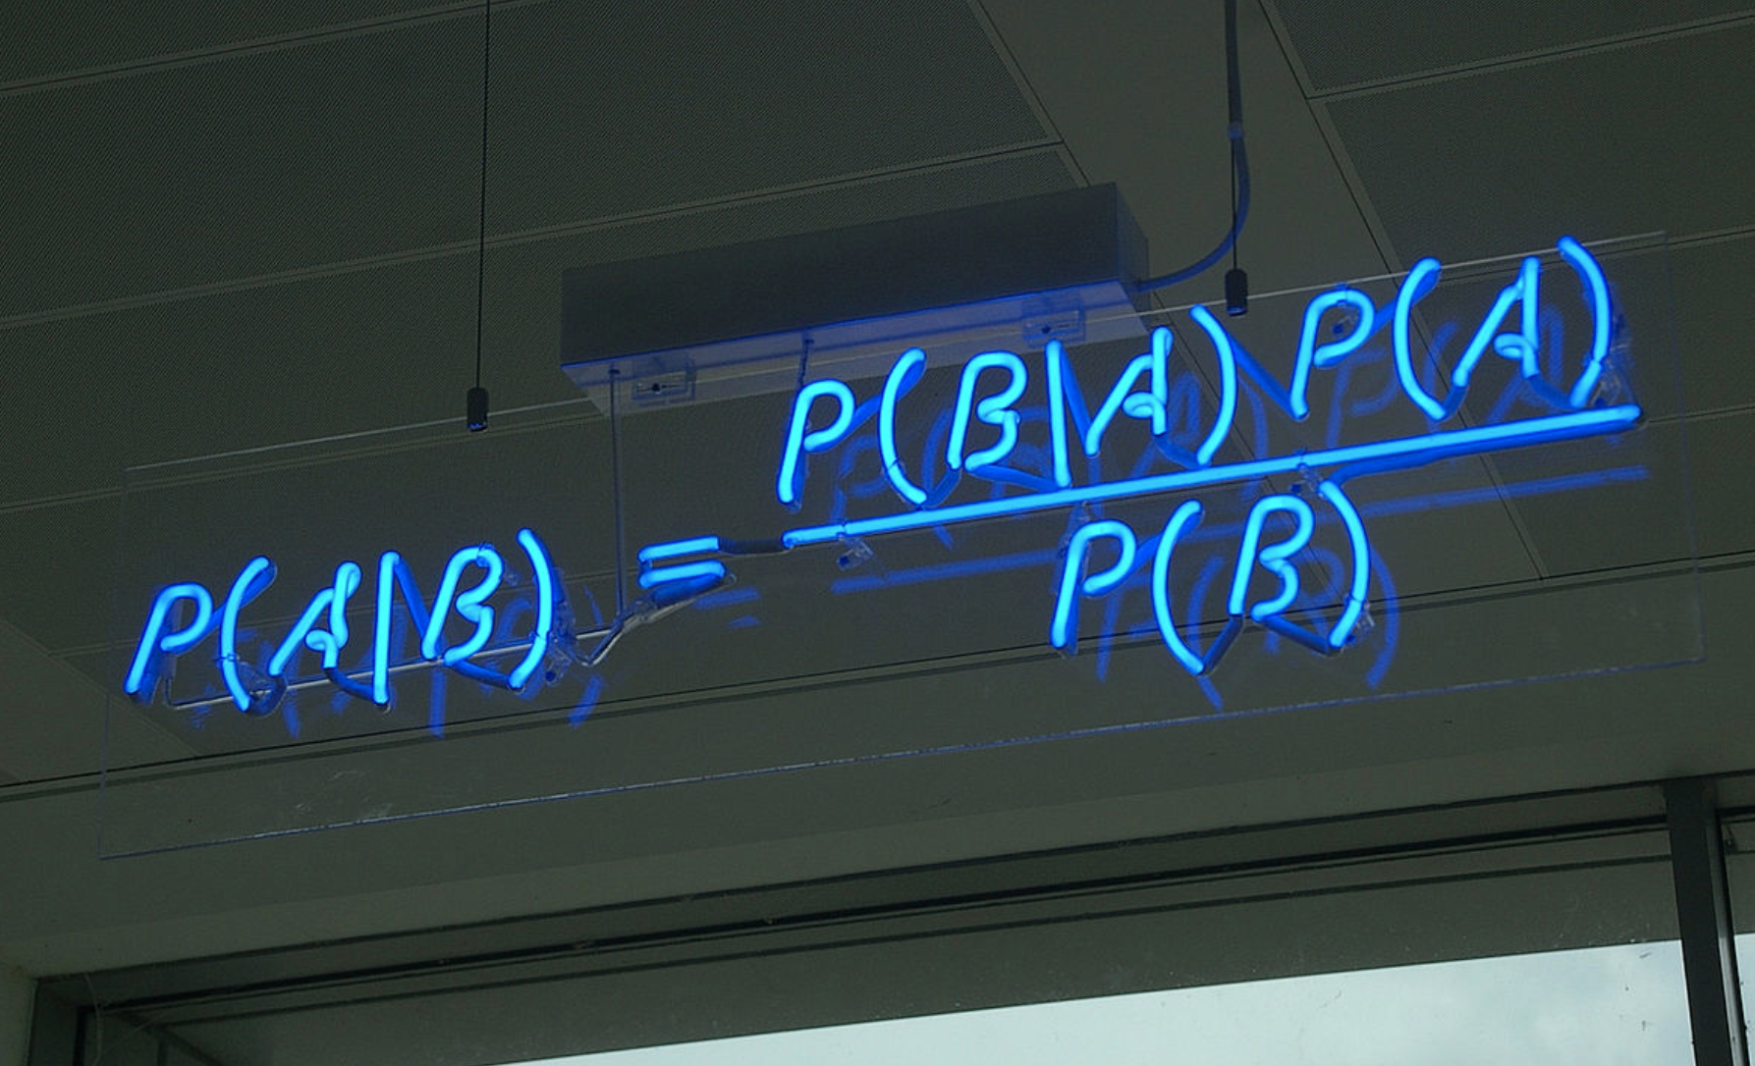
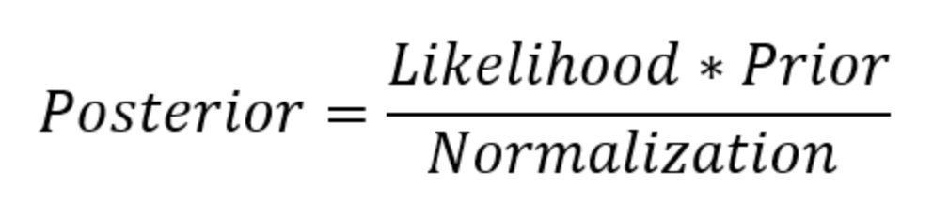
Bayes Rule
Why is this useful?
Posterior is proportional to likelihood × prior
P(A) is the prior and P(A|B) is the posterior
P(B|A) is the likelihood
P(B) is the marginal
Theoretical foundation of Bayesian inference

Slide 18
Bayes Rule example
Marie is getting married tomorrow, at an outdoor ceremony in the desert. In recent years, it has rained only 5 days each year (5/365 = 0.014). Unfortunately, the weatherman has predicted rain for tomorrow. When it actually rains, the weatherman correctly predicts rain 90% of the time. When it doesn't rain, he incorrectly predicts rain 10% of the time. What is the probability that it will rain on Marie's wedding?

Slide 19
Bayes rule: Example
1% of women at age 40 who take routine screening test have breast cancer. 80% of women with breast cancer will get positive test result. 9.6% of women without breast cancer will also get positive test result. Suppose a woman in this age group had a positive test result in a routine screening. What is the probability that she actually has breast cancer?

Slide 20
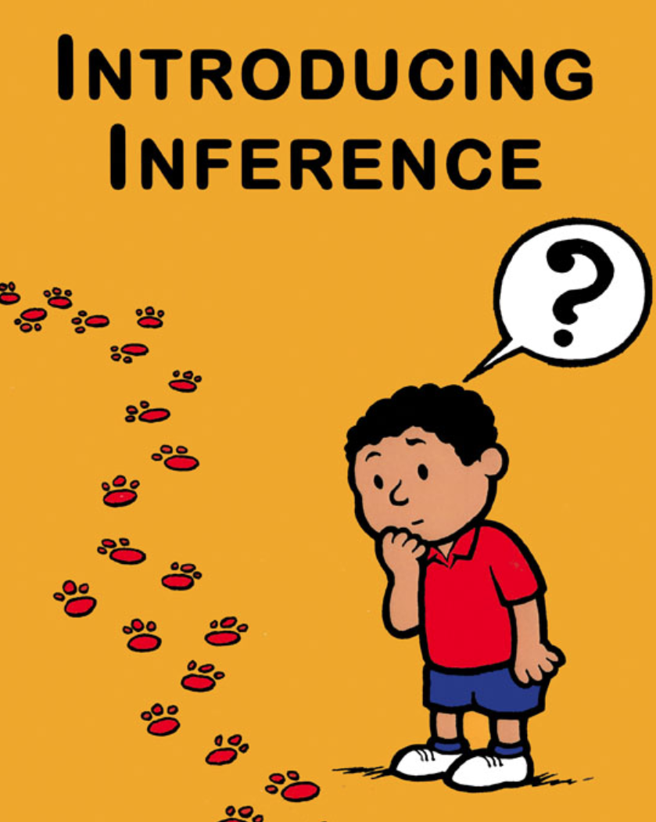
Bayesian inference
Before we move on to Bayesian inference, let’s take on a look at what inference is.

Slide 21
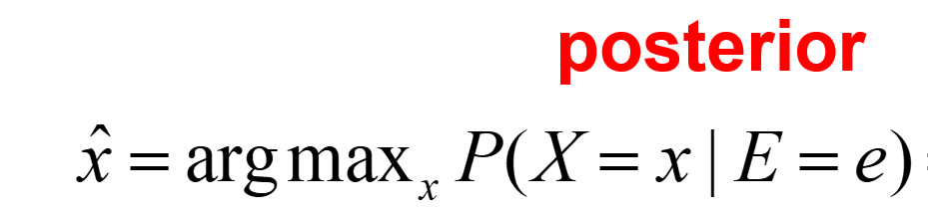
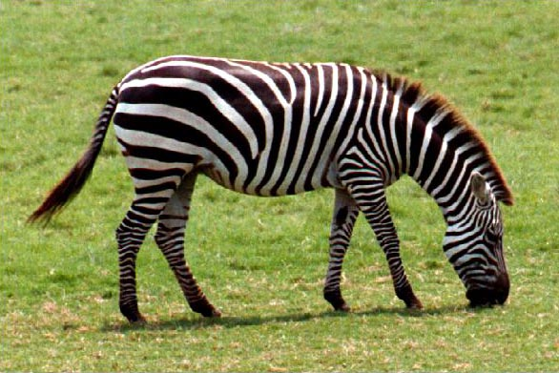

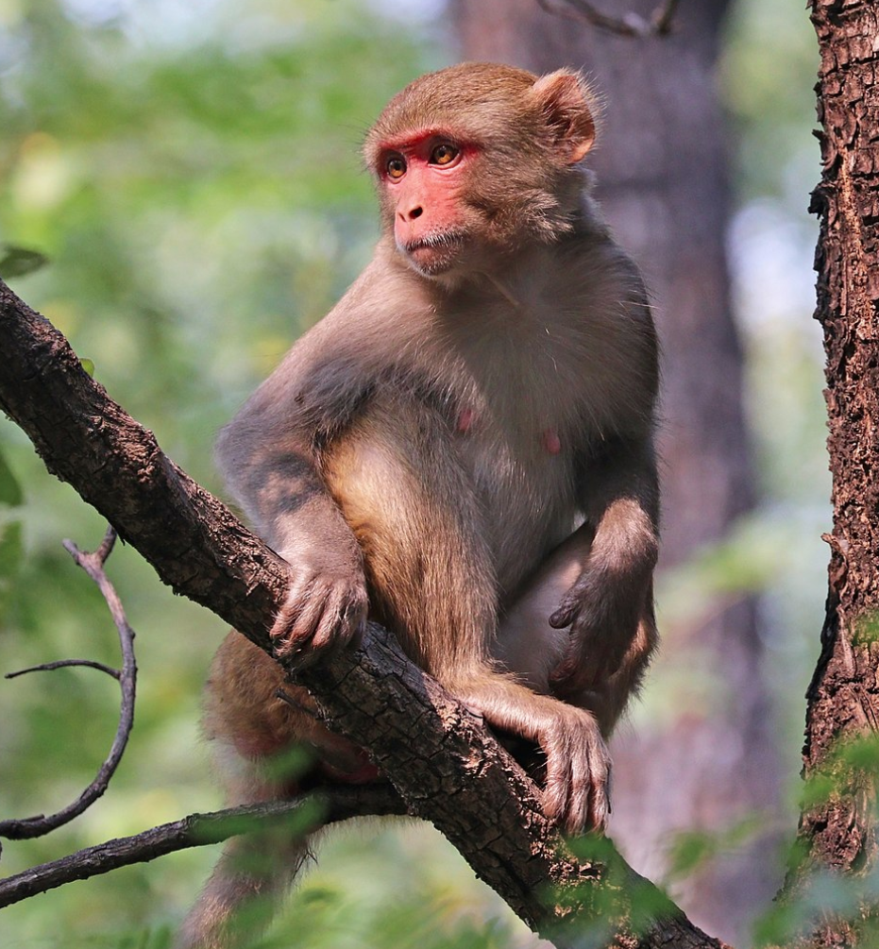
Inference problem
Given the value of some evidence variable E = e, find the value x of query variable X that maximize the posterior probability:
Examples:
e = image features, X = {tiger, monkey, zebra},

Slide 22
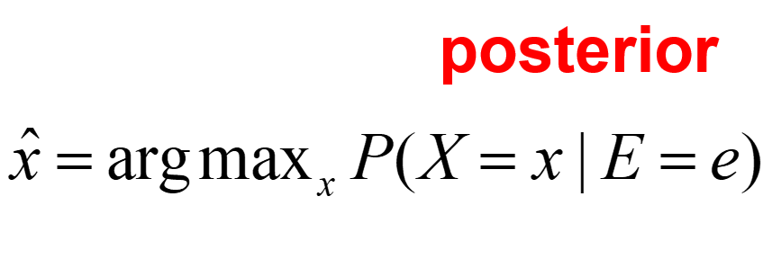
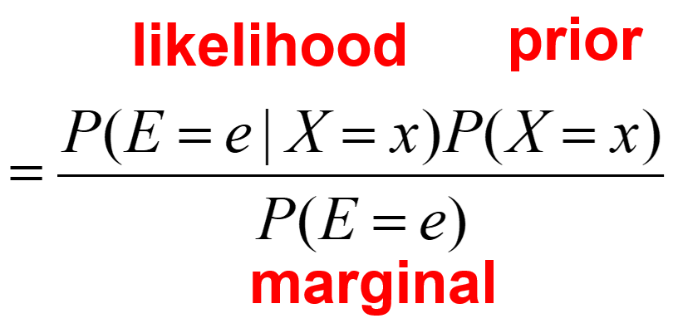
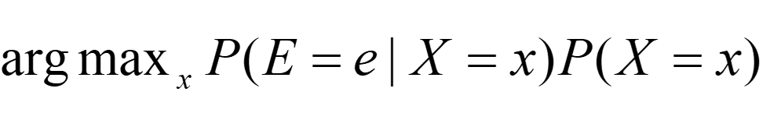
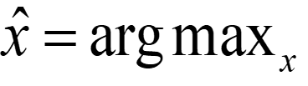
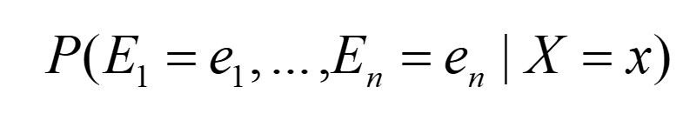
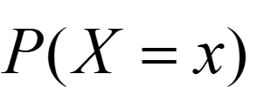
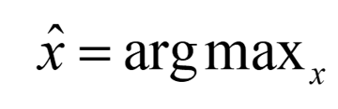
Bayesian inference (apply Bayes rule )
P(E=e) is constant, so we have
If we have multiple evidences (features) E₁, …, E_{n} :
If we assume that E₁, …, E_{n} are conditionally independent :
Here we reduce the inference problem to the problem of estimating likelihood and priors

Slide 23
Case study: Text document classification
Inference: assign a document to the class with the highest posterior P(class | document)
Question: What are evidence variable and query variable?
Goal: estimate likelihoods P(document | class) and priors P(class)
Likelihood: bag of words model
The document is a sequence of words (w₁, …, w_{n})
The order of the words in the document is not important
Each word is independent of the others given document class
Can be computes as:
Product of the likelihoods of individual words

Slide 24
Parameter estimation
How do we obtain likelihoods of individual words?
We need training data of labeled documents
Naïve approach:
Any problem?
# of occurrences of this word in this class
P(word | class) =
total # of words in this class

Slide 25
Parameter estimation
If training data is not very large, the above method may not work very well.
We need to make sure likelihoods are not zero or too small.
Solution: Smoothing:
Used to make sure likelihoods are not zero or too small.
Laplace smoothing: mixing true likelihood in training data with uninform distribution
# of occurrences of this word in this class + 1
P(word | class) =
total # of words in class + V
(V: total number of unique words)

Slide 26
Example (Politics or Sports?)
new doc:
X = “Obama likes basketball”
Training set
Politics
Sports
“Obama meets Merkel”
“Obama elected again”
“Merkel visits Greece again”
“OSFP European basketball champion”
“Miami NBA basketball champion”
“Greece basketball coach?”
P(p) = 0.5
P(s) = 0.5
terms
obama:2, meets:1, merkel:2, elected:1, again:2, visits:1, greece:1
OSFP:1, european:1, basketball:3, champion:2, miami:1, nba:1, greece:1, coach:1
Total # of terms: 10
Total # of terms: 11
Vocabulary (distinct terms) size: 14

Slide 27
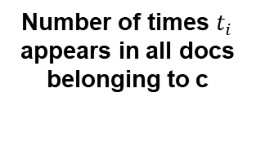
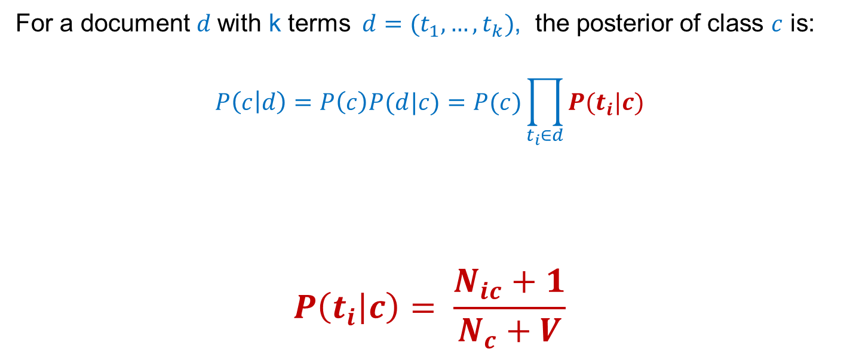

Example (Politics or Sports?)
For a document $d$with k terms $d=(t_{1},…, t_{k})$, the posterior of class $c$ is:
$$P\left(c | d\right)=P\left(c\right)P(d|c)=P(c)\prod_{t_{i}∈d}{P(t_{i}|c)}$$
$$P\left(t_{i} | c\right)= \frac{N_{ic}+1}{N_{c}+V}$$
Number of times $t_{i}$ appears in all docs belonging to c
Laplace Smoothing
Likelihood of $t_{i}$ in c
Total number of unique words
(vocabulary size)
Total number of terms in all docs
belonging to c

Slide 28
Example (Politics or Sports?)
Politics
Sports
Documents in training
“Obama meets Merkel”
“Obama elected again”
“Merkel visits Greece again”
“OSFP European basketball champion”
“Miami NBA basketball champion”
“Greece basketball coach?”
P(p) = 0.5
P(s) = 0.5
terms
obama:2, meets:1, merkel:2, elected:1, again:2, visits:1, greece:1
OSFP:1, european:1, basketball:3, champion:2, miami:1, nba:1, greece:1, coach:1
Vocabulary size: 14
Total # of terms: : 10
Total # of terms: 11
new doc:
X = “Obama likes basketball”
P(Politics|X) = P(p)*P(obama|p)*P(likes|p)*P(basketball|p)
= 0.5 * (2+1)/(10+14) *(0+1)/(10+14) * (0+1)/(10+14) = 0.000108
P(Sports|X) = P(s)*P(obama|s)*P(likes|s)*P(basketball|s)
= 0.5 * (0+1)/(11+14) *(0+1)/(11+14) * (3+1)/(11+14) = 0.000128

